Slide 1
Lead Score Case Study
Submitted by:
Nutan Patel
Shivam
Samantha

Slide 2
Problem Statement
X Education, an online course selling education company, needs assistance in recognising and selecting promising leads that will most likely convert to paying customers.
X Education gets a lot of leads but lead conversion rate is poor
So our aim is to analyse and identify variables which leads to higher customer conversion rate. This is done by building a logistic regression model that can assign a lead score to each of the leads such that customers with high lead score have a higher chance of conversion.

Slide 3
Assumptions and modiﬁcations on the data set
We dropped columns in which 45 or more percent of the data were missing.
Since nearly half of the data were missing in few columns, we couldn’t consider them for model building. We assumed that these columns will not have much inﬂuence on conversion rate.
We imputed the missing values in continuous variables with median and those in categorical variables with mode. However, few categorical variables had missing value count more than that of mode, in such cases we replaced the missing values with ‘Not mentioned’.
In few of the categorical columns we had highly varying counts for levels ,so we grouped less frequent levels together to avoid model picking on the highly underrepresented dummy levels.
We handled outliers in continuous variables by capping them at 99th percentile.

Slide 4
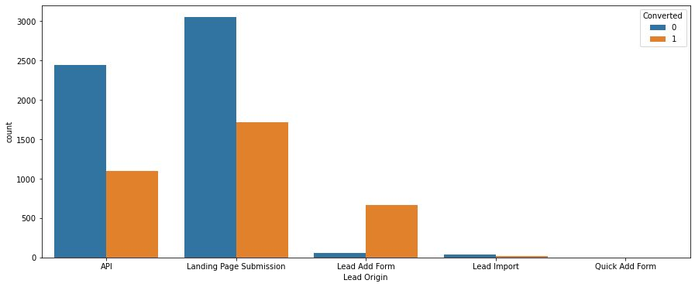
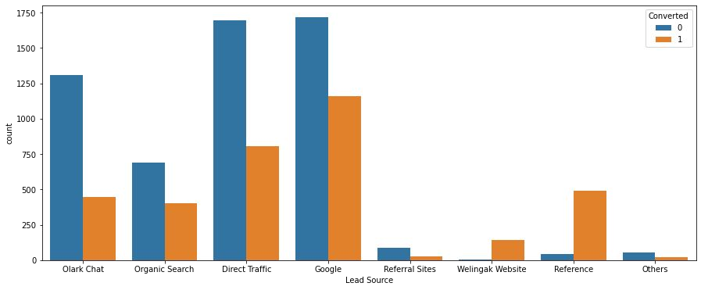
EDA Results
# Lead_Origin
'Landing page submission' is the most common 'lead origin' and the number of converted leads is also higher for this level.
The lead conversion rate is very high among the customers with 'Lead add form' origin.
# Lead_source
Google and Direct Trafﬁc are the two major lead sources.
However 'Reference' has the highest lead conversion rate.

Slide 5
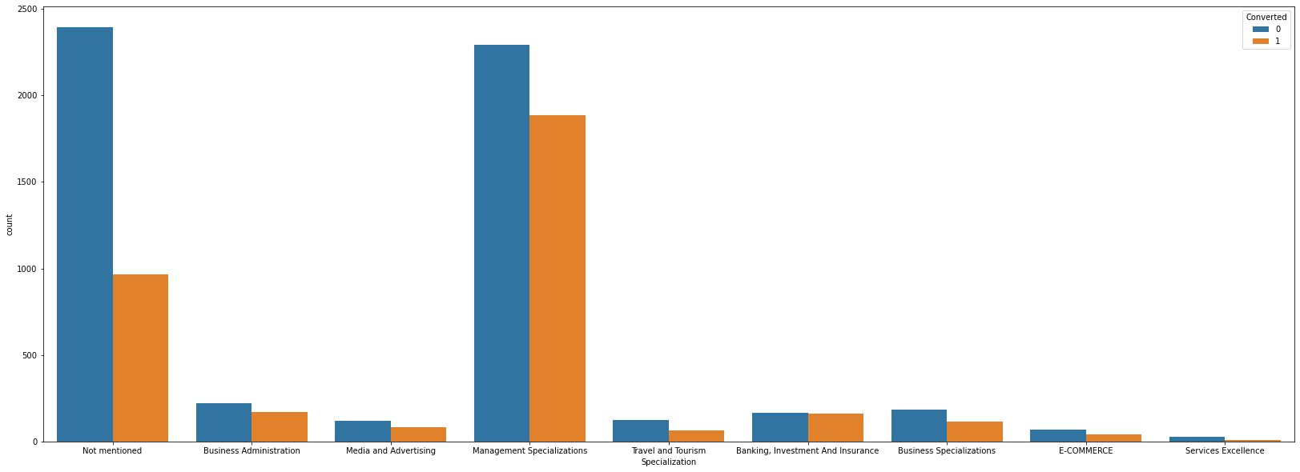
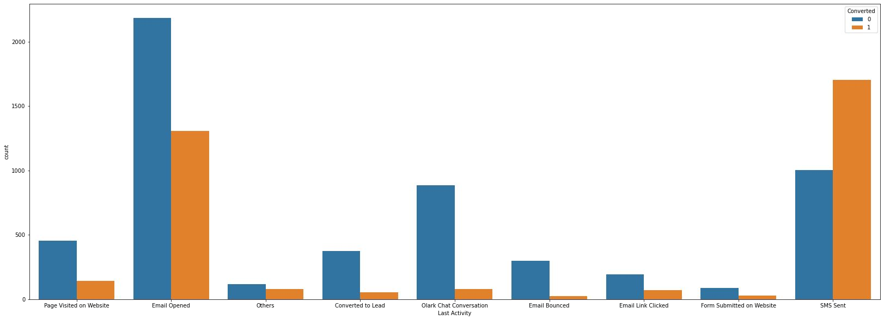
EDA Results
# Specialization
Most of the customers prefer not to mention their specialization
Among the customers who have mentioned their specializations,most of them fall into Management domain.
# Last Activity
Lead conversion rate is very high among customers whose last activity is 'SMS sent'
Lead conversion rate is very low among customers with last activity as 'Olark chat conversion'
Most customer's last activity is 'Email opened'

Slide 6
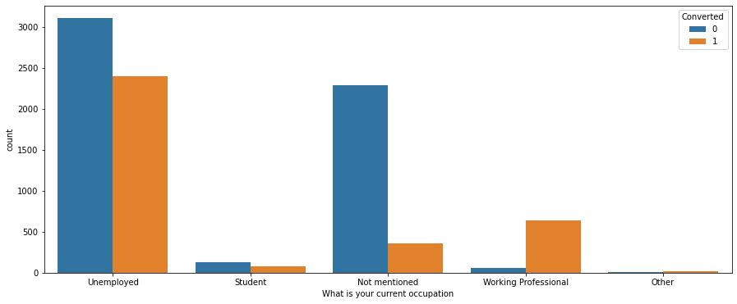
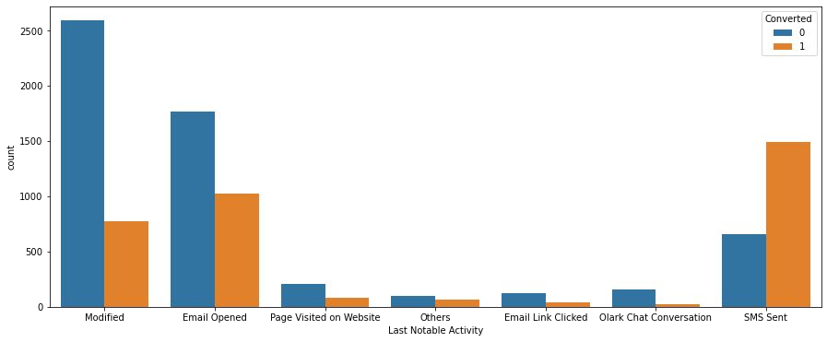
EDA Results
# What is your current occupation
The number of unemployed people purchasing online courses are high.
Most of the working professionals who check out the courses end up purchasing them.
# Last Notable Activity
Most of the customers belong to 'modiﬁed' category of 'Last Notable Activity'
The lead conversion rate is very high among people in 'SMS Sent' category

Slide 7
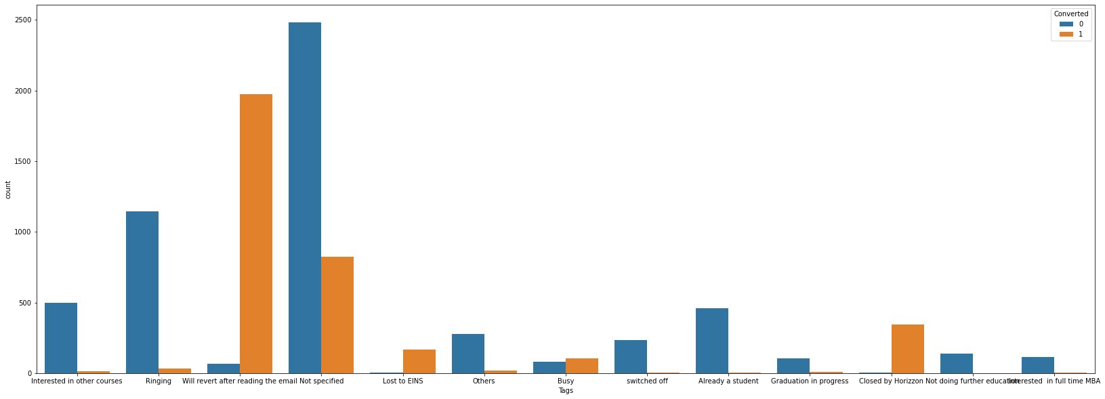
EDA Results
# Tags
Customers who are tagged as 'will revert after reading the email' or ‘Closed by Horizzon’ are more likely to purchase the courses.
Leads in ‘Lost to EINS seems to have very high lead conversion rate.
Leads who are tagged as ‘Switched off’,’Ringing’ and ‘Already a student’ are unlikely to purchase the course materials.

Slide 8
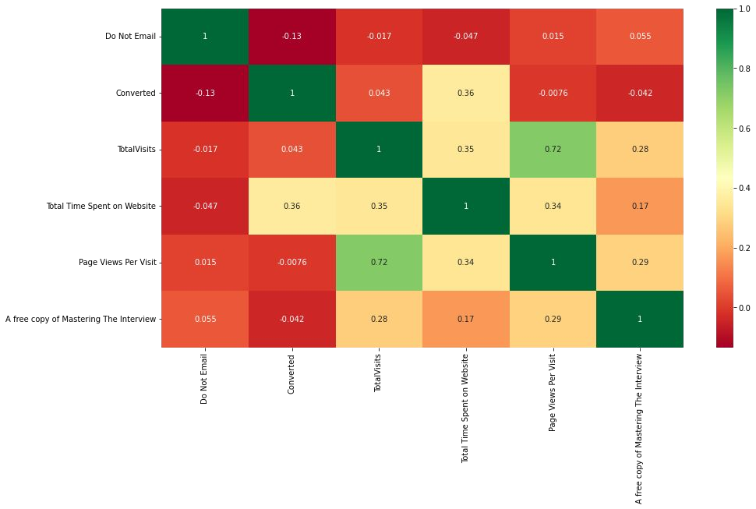
EDA Results
# Heat map with correlation coefﬁcients of all the numerical variables
Our target variable 'Converted' has a positive correlation with 'Total Time Spent On Website' with a correlation coefﬁcient of 0.36
The more a lead spends time on X Education’s website the more is the chances of lead conversion.
Other numerical variables do not seem to have any strong correlation with our target variable ‘Converted’.

Slide 9
Approach
After exploratory data analysis, we created dummy variables for categorical variables. Since k-1 dummies can take care of all the information contained in a categorical variable with k levels,We dropped one dummy from dummies created for each column. Our dataframe was later split into two,one for training the model and the other for validating the model. Numerical variables were normalized so that they wouldn’t have any disproportionate effect on the model’s results.We found that in the given data set there was a lead conversion rate of 38.45%.This is neither exactly 'balanced' (which a 50-50 ratio would be called) nor heavily imbalanced. So we didn’t have to do any special treatment for this dataset .we had 54 features in in the dataset, since it was not feasible to use all the variables, we eliminated a few features using Recursive Feature Elimination (RFE) and selected 20 features for Model building

Slide 10
Model building
We built a model using the features selected by RFE. In that model one feature was insigniﬁcant(had a p value less than 0.05), we dropped that feature and rebuilt the model in which all the features were statistically signiﬁcant and had a VIF value below 2(there is no issue of multicollinearity). We used this model as our ﬁnal model
Using logistic regression curve’s ‘predict’ function we computed the probabilities of lead conversion.
The logistic curve gives just the probabilities and not the actual classiﬁcation of lead conversion(converted/not converted). We chose 0.5 as an arbitrary cutoff wherein if the probability of a particular lead converting is less than 0.5,we would classify it as 'unconverted' and if it's greater than 0.5, we would classify it as 'Converted'

Slide 11
Model Evaluation
Since we were classifying the leads into two classes, we had some errors. The classes of errors that were there are: 'Converted' leads being (incorrectly) classiﬁed as 'not converted' and 'not converted' leads being (incorrectly) classiﬁed as 'Converted'
To capture these errors, and to evaluate how well the model performs, we used 'Confusion Matrix'. Model sensitivity and speciﬁcity were calculated
Our model had a sensitivity around 88.8% and speciﬁcity around 96.3%
We plotted a ROC curve and found that our curve is towards the upper-left corner and there is a larger area under the curve (AUC) indicating that the model is good.
Our model had very high speciﬁcity value but sensitivity value was relatively lower.So we needed to ﬁnd an optimum cut-off to have a good balance between these two. For this we plotted accuracy sensitivity and speciﬁcity for various probabilities and picked 0.3 as optimum cut-off.
lead score for every lead in the dataframe were calculated by multiplying their conversion probability with 100.

Slide 12
Results & conclusions
Evaluation metrics before and after choosing the optimum cut-off for conversion probability.
Earlier with 0.5 cut-off
accuracy: 93.4% sensitivity : 88.8% speciﬁcity : 96.3%
After choosing the optimum cut-off at 0.3
accuracy : 93% ->sensitivity : 93.7% speciﬁcity : 92.6%
Predictions were made on test set and model’s performance was evaluated
accuracy : 93.3% sensitivity : 93% speciﬁcity : 93.5%
Model is able to correctly predict ~93% of the converted labels
Model is able to correctly predict ~93% of the unconverted labels

Slide 13
Recommendations
X education can use our model and give a lead score for every lead. Once the leads have been scored, the sales team can focus on leads with scores above 30(since our probability cut off was 0.3) to ensure higher lead conversion.
Sales team doesn't want to miss calling leads tagged as Lost to EINS (coef 6.3616),Closed by Horizon (coef 5.5389) or lead source with Welingak Website (coef 3.7183) as they have higher coefﬁcient values in our model. Higher coefﬁcient values of these dummy variables indicate that there is a higher chance of lead conversion among leads with these dummies. Sales team may avoid calling leads who are tagged as switched off (coef -5.7080),Ringing (coef -4.5025) or Already a student (coef -4.3912),as their coefﬁcient values are highly negative in our model and they will affect the conversion probability negatively.

